Slide 1


High Performance Cluster Computing
Architectures and Systems
Hai Jin
Internet and Cluster Computing Center

Slide 2
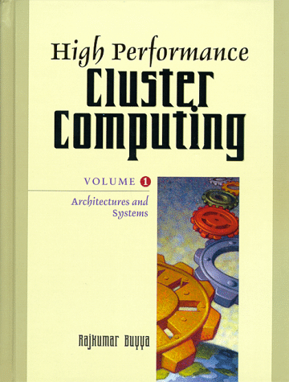
Software RAID and Parallel Filesystems
Introduction
Physical Placement of Data
Caching
Prefetching
Interface

Slide 3
Introduction (I)
I/O problems
  Cluster of workstations has the great amount of resources
  These large number of resources were not accessible from all the nodes in the network
  Only the process running on the node that had a given resource attached were able to use it
  If there was a way to access those remote resources, the steps that had to be done were neither simple nor transparent
  These resources have to be accessible from any node (Single System Image)

Slide 4
Introduction (II)
I/O problems
  These cluster of workstations end up being very similar to parallel machines
    The same kind of applications can be run on them
    The problem is founded when executing these applications
      need a high performance I/O system
    These applications work with very large data sets, which cannot be kept in memory
    They expect a fast file system that is able to write & read this data very rapidly
    When parallel applications are run on the cluster of workstations, the I/O system should allow cooperative operations

Slide 5
Introduction (III)
I/O problems
  Need to design high performance file systems
    Simplify the cooperation between processes
    Be able to use all the resources efficiently & in an a transparent way

Slide 6
Introduction (IV)
Using Clusters to Increase the I/O performance
  To achieve a high performance file system
    need to examine the characteristics a cluster of workstations has & the way we should use them to build better file system
  Advantages
    Great quantity of resources
      Disks that can be used in parallel
      Large amounts of memory to build big filesystem caches
    High-speed interconnection network
      Relay on remote nodes to perform many tasks
      Use the memory of a remote node for cache blocks
    Getting closer to parallel machines
      Parallel machine’s skills can be applied

Slide 7
Physical Placement of Data (I)
Designing a file system for a cluster of workstations
  Problems
    Visibility
      On one hand, many disks scattered among the nodes
      On the other hand, want to use them from any node in the cluster
    Achieving a high performance I/O system
      Disks are mainly built of mechanical components that slow down the most common operations (head movement, disk rotation, etc)
  The only solution left to increase the disk performance at this level
    Placing the data in such a way that the mechanical parts have as little effect as possible on the global disk performance

Slide 8
Physical Placement of Data (II)
Increasing the Visibility of the File systems
  The first problem found in a cluster of workstations
    Small visibility
      While many disks are available, only the ones attached to the node where a process is running are visible to that process
    Many distributed systems have used the mount concept of Unix to increase the visibility
  Mounting Remote Filesystems
  To maintain the remote-mount information
    Two possibility
      maintaining the mount information at clients (NFS)
      to maintain the mount information at servers (Sprite filesystem)
    Solution: caching mechanism

Slide 9
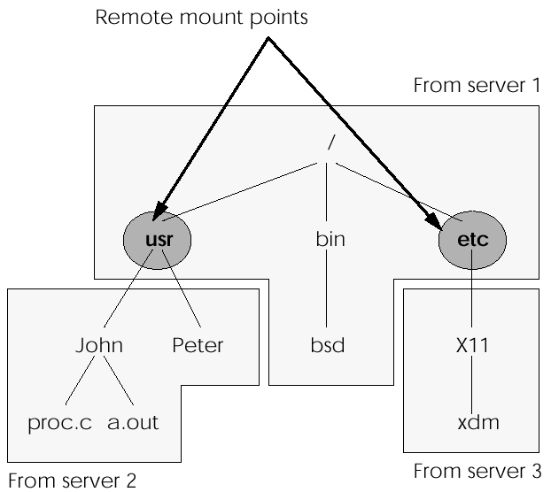
Directory Tree Build Mixing Remote and Local Filesystems

Slide 10
Physical Placement of Data (III)
Name Resolution
  This consists of locating a file or directory given its name
  Two approaches to this problem
    Centralized name-resolution scheme
    Distributed name-resolution scheme
  Centralized name-resolution scheme
    One node is responsible for mapping table
    A failure in the node results in a failure of the whole filesystem
    Centralized server might become a bottleneck in larger systems

Slide 11
Physical Placement of Data (IV)
Name Resolution
  Distributed name-resolution scheme
    Two different ways
      Each system builds its own name space (Sun NFS)
        Each system knows the filesystems that have been mounted and the node that holds them - movement problem
      There is a unique global structure (domain)
        single name space for all workstations
        name sever is responsible for one of these domains
        to increase the performance of this name resolution, the system may keep a cache of which nodes have the most popular files or directories

Slide 12
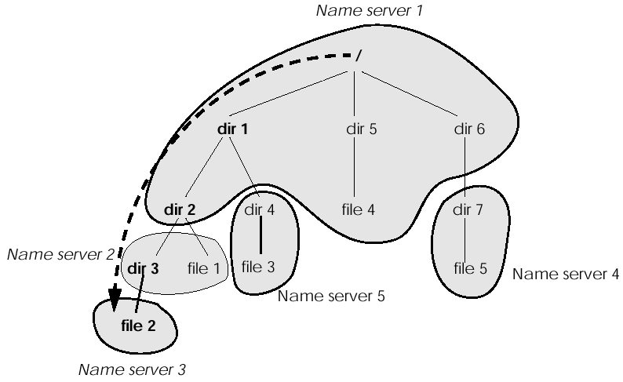
Example of Dividing a Directory Tree into Domains

Slide 13
Physical Placement of Data (V)
Data Striping
  Distribute the data among the disks so that it can be fetched from as many disks as possible in parallel
  The first time this idea was used was in building a high-bandwidth “single disk”
    Connect several disks to a single controller and give the impression that the disk had a higher data transfer bandwidth
  RAID – Redundant Arrays of Inexpensive Disks

Slide 14
Physical Placement of Data (VI)
RAIDs
  Three reasons of the high performance
    Data from each disk can be fetched at the same time, increasing the disk bandwidth
    All disks can perform the seek operation in parallel, decreasing its times
    More than one request may be handled in parallel
  Data interleaving
    Fine-grained disk arrays
      Interleave data in relatively small units so that all I/O requests access all the disks in the disk array
      Very high data transfer rates for all I/O requests
      Only one logical I/O request can be served
      Waste time positioning for every request
    Coarse-grained disk arrays
      Interleave data in relatively large units so that all I/O requests need only to access a small number of disks & large requests can access all disks
      Multiple small requests to be serviced in parallel
  RAID needs a fault-tolerance mechanism to allow a disk failure without losing the information kept in the failed disk

Slide 15
RAID (I)
RAID Level 0
  Characteristics/Advantages
    RAID 0 implements a striped disk array, the data is broken down into blocks and each block is written to a separate disk drive
    I/O performance is greatly improved by spreading the I/O load across many channels and drives
    Best performance is achieved when data is striped across multiple controllers with only one drive per controller
    No parity calculation overhead is involved
    Very simple design
    Easy to implement
  Disadvantages
    Not a "True" RAID because it is NOT fault-tolerant
    The failure of just one drive will result in all data in an array being lost
    Should never be used in mission critical environments
  Recommended Applications
    Video Production and Editing
    Image Editing
    Pre-Press Applications
    Any application requiring high bandwidth

Slide 16
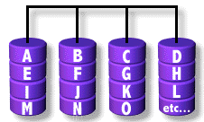
RAID 0: Striped Disk Array without Fault Tolerance
RAID Level 0 requires a minimum of 2 drives to implement

Slide 17
RAID (II)
RAID Level 1
  Characteristics/Advantages
    One Write or two Reads possible per mirrored pair
    Twice the Read transaction rate of single disks, same Write transaction rate as single disks
    100% redundancy of data means no rebuild is necessary in case of a disk failure, just a copy to the replacement disk
    Transfer rate per block is equal to that of a single disk
    Under certain circumstances, RAID 1 can sustain multiple simultaneous drive failures
    Simplest RAID storage subsystem design
  Disadvantages
    Highest disk overhead of all RAID types (100%) - inefficient
    Typically the RAID function is done by system software, loading the CPU/Server and possibly degrading throughput at high activity levels. Hardware implementation is strongly recommended
    May not support hot swap of failed disk when implemented in "software"
  Recommended Applications
    Accounting
    Payroll
    Financial
    Any application requiring very high availability

Slide 18
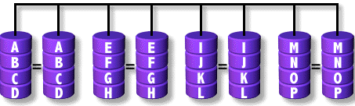
RAID 1: Mirroring and Duplexing
For Highest performance, the controller must be able to perform two concurrent
separate Reads per mirrored pair or two duplicate Writes per mirrored pair.
RAID Level 1 requires a minimum of 2 drives to implement

Slide 19
RAID (III)
RAID Level 2
  Characteristics/Advantages
    "On the fly" data error correction
    Extremely high data transfer rates possible
    The higher the data transfer rate required, the better the ratio of data disks to ECC disks
    Relatively simple controller design compared to RAID levels 3,4 & 5
  Disadvantages
    Very high ratio of ECC disks to data disks with smaller word sizes - inefficient
    Entry level cost very high - requires very high transfer rate requirement to justify
    Transaction rate is equal to that of a single disk at best (with spindle synchronization)
    No commercial implementations exist / not commercially viable

Slide 20
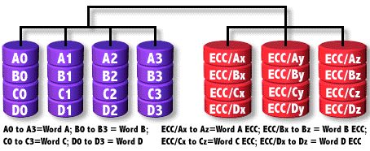
RAID 2: Hamming Code ECC
Each bit of data word is written to a data disk drive (4 in this example: 0 to 3).
Each data word has its Hamming Code ECC word recorded on the ECC disks.
On Read, the ECC code verifies correct data or corrects single disk errors

Slide 21
RAID (IV)
RAID Level 3
  Characteristics/Advantages
    Very high read data transfer rate
    Very high write data transfer rate
    Disk failure has an insignificant impact on throughput
    Low ratio of ECC (Parity) disks to data disks means high efficiency
  Disadvantages
    Transaction rate equal to that of a single disk drive at best (if spindles are synchronized)
    Controller design is fairly complex
    Very difficult and resource intensive to do as a "software" RAID
  Recommended Applications
    Video production and live streaming
    Image editing
    Video editing
    Prepress applications
    Any application requiring high throughput

Slide 22
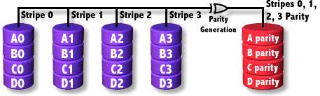
RAID 3: Parallel Transfer with Parity
The data block is subdivided ("striped") and written on the data disks.
Stripe parity is generated on Writes, recorded on the parity disk and checked on Reads.
RAID Level 3 requires a minimum of 3 drives to implement

Slide 23
RAID (V)
RAID Level 4
  Characteristics/Advantages
    Very high read data transaction rate
    Low ratio of ECC (Parity) disks to data disks means high efficiency
    High aggregate read transfer rate
  Disadvantages
    Quite complex controller design
    Worst write transaction rate and write aggregate transfer rate
    Difficult and inefficient data rebuild in the event of disk failure
    Block read transfer rate equal to that of a single disk
    Unbalanced load for parity disk

Slide 24

RAID 4: Independent Data Disks with Shared Parity Disk
Each entire block is written onto a data disk. Parity for same rank blocks is generated on writes, recorded on the parity disk and checked on Reads.
RAID Level 4 requires a minimum of 3 drives to implement

Slide 25
RAID (VI)
RAID Level 5
  Characteristics/Advantages
    Highest read data transaction rate
    Medium write data transaction rate
    Low ratio of ECC (Parity) disks to data disks means high efficiency
    Good aggregate transfer rate
    Balanced load for all the disks
  Disadvantages
    Disk failure has a medium impact on throughput
    Most complex controller design
    Difficult to rebuild in the event of a disk failure (as compared to RAID level 1)
    Individual block data transfer rate same as single disk
    Small write problem
  Recommended Applications
    File and application servers
    Database servers
    WWW, E-mail, and News servers
    Intranet servers
    Most versatile RAID level

Slide 26
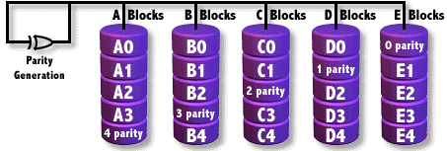
RAID 5: Independent Data Disks with Distributed Parity Blocks
Each entire data block is written on a data disk; parity for blocks in the same rank is generated on Writes, recorded in a distributed location and checked on Reads.
RAID Level 5 requires a minimum of 3 drives to implement

Slide 27
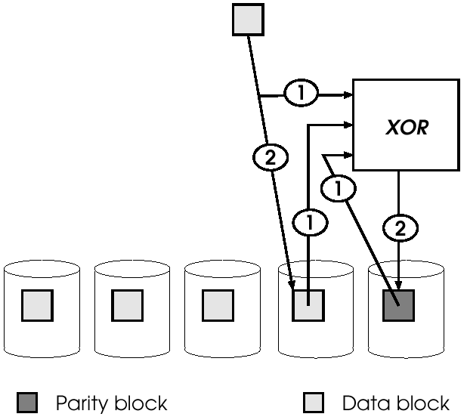
Read-Write-Modify

Slide 28
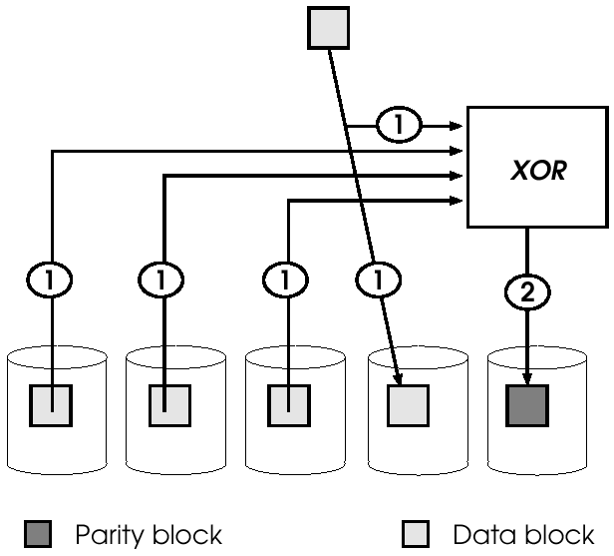
Regenerate-Write

Slide 29
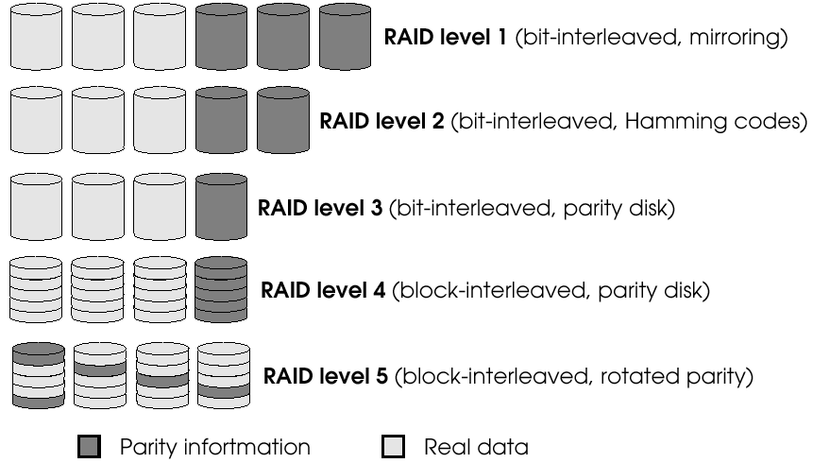
Graphic Representation of the Five Levels of RAIDs

Slide 30
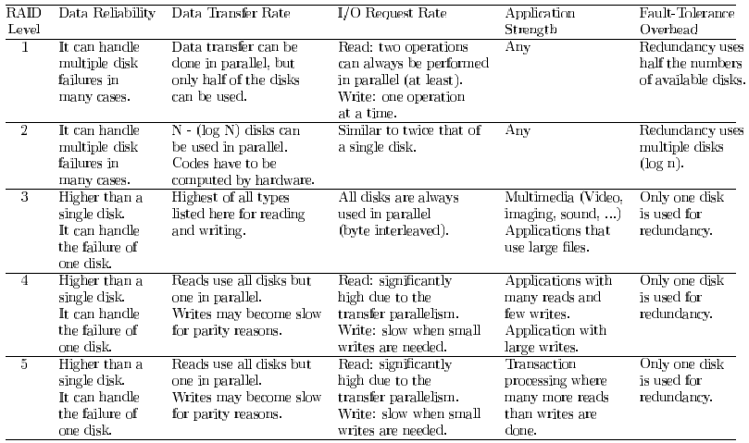
Comparison Between RAID Levels

Slide 31
RAID (VII)
RAID Level 6
  Characteristics/Advantages
    An extension of RAID level 5 which allows for additional fault tolerance by using a second independent distributed parity scheme (two-dimensional parity)
    Data is striped on a block level across a set of drives, just like in RAID 5, and a second set of parity is calculated and written across all the drives
    RAID 6 provides for an extremely high data fault tolerance and can sustain multiple simultaneous drive failures
    Perfect solution for mission critical applications
  Disadvantages
    Very complex controller design
    Controller overhead to compute parity addresses is extremely high
    Very poor write performance
    Requires N+2 drives to implement because of two-dimensional parity scheme

Slide 32
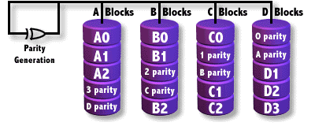
RAID 6: Independent Data Disks with Two Independent Distributed Parity Schemes

Slide 33
RAID (VIII)
RAID Level 7
  Architectural Features
    All I/O transfers are asynchronous, independently controlled and cached including host interface transfers
    All reads and write are centrally cached via the high speed x-bus
    Dedicated parity drive can be on any channel
    Fully implemented process oriented real time operating system resident on embedded array control microprocessor
    Embedded real time operating system controlled communications channel
    Open system uses standard SCSI drives, standard PC buses, motherboards and memory SIMMs
    High speed internal cache data transfer bus (X-bus)
    Parity generation integrated into cache
    Multiple attached drive devices can be declared hot standbys
    Manageability: SNMP agent allows for remote monitoring and management

Slide 34
RAID (IX)
RAID Level 7 (cont’d)
  Characteristics/Advantages
    Overall write performance is 25% to 90% better than single spindle performance and 1.5 to 6 times better than other array levels
    Host interfaces are scalable for connectivity or increased host transfer bandwidth
    Small reads in multi user environment have very high cache hit rate resulting in near zero access times
    Write performance improves with an increase in the number of drives in the array
    Access times decrease with each increase in the number of actuators in the array
    No extra data transfers required for parity manipulation
    RAID 7 is a registered trademark of Storage Computer Corporation.
  Disadvantages
    One vendor proprietary solution
    Extremely high cost per MB
    Very short warranty
    Not user serviceable
    Power supply must be UPS to prevent loss of cache data

Slide 35
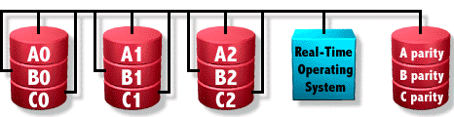
RAID 7: Optimized Asynchrony for High I/O Rates as well as High Data Transfer Rates

Slide 36
RAID (X)
RAID Level 10
  Characteristics/Advantages
    RAID 10 is implemented as a striped array whose segments are RAID 1 arrays
    RAID 10 has the same fault tolerance as RAID level 1
    RAID 10 has the same overhead for fault-tolerance as mirroring alone
    High I/O rates are achieved by striping RAID 1 segments
    Under certain circumstances, RAID 10 array can sustain multiple simultaneous drive failures
    Excellent solution for sites that would have otherwise gone with RAID 1 but need some additional performance boost
  Disadvantages
    Very expensive / High overhead
    All drives must move in parallel to proper track lowering sustained performance
    Very limited scalability at a very high inherent cost
  Recommended Applications
    Database server requiring high performance and fault tolerance

Slide 37
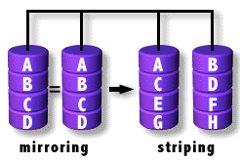
RAID 10: Very High Reliability Combined with High Performance
RAID Level 10 requires a minimum of 4 drives to implement

Slide 38
RAID (XI)
RAID Level 0+1
  Characteristics/Advantages
    RAID 0+1 is implemented as a mirrored array whose segments are RAID 0 arrays
    RAID 0+1 has the same fault tolerance as RAID level 5
    RAID 0+1 has the same overhead for fault-tolerance as mirroring alone
    High I/O rates are achieved thanks to multiple stripe segments
    Excellent solution for sites that need high performance but are not concerned with achieving maximum reliability
  Disadvantages
    RAID 0+1 is NOT to be confused with RAID 10. A single drive failure will cause the whole array to become, in essence, a RAID level 0 array
    Very expensive / High overhead
    All drives must move in parallel to proper track lowering sustained performance
    Very limited scalability at a very high inherent cost
  Recommended Applications
    Imaging applications
    General fileserver

Slide 39
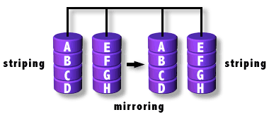
RAID 0+1: High Data Transfer Performance
RAID Level 0+1 requires a minimum of 4 drives to implement

Slide 40
RAID (XII)
RAID Level 53
  Characteristics/Advantages
    RAID 53 should really be called "RAID 03" because it is implemented as a striped (RAID level 0) array whose segments are RAID 3 arrays
    RAID 53 has the same fault tolerance as RAID 3 as well as the same fault tolerance overhead
    High data transfer rates are achieved thanks to its RAID 3 array segments
    High I/O rates for small requests are achieved thanks to its RAID 0 striping
    Maybe a good solution for sites who would have otherwise gone with RAID 3 but need some additional performance boost
  Disadvantages
    Very expensive to implement
    All disk spindles must be synchronized, which limits the choice of drives
    Byte striping results in poor utilization of formatted capacity

Slide 41
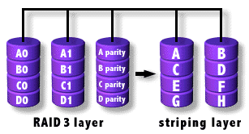
RAID 53: High I/O Rates and Data Transfer Performance
RAID Level 53 requires a minimum of 5 drives to implement

Slide 42
Physical Placement of Data (VII)
Logical RAIDs (Software RAID)
  Not connected to a single controller
  Strip the data among the disks in the networks
  Filesystem is responsible for both distributing the data and maintaining the desired tolerance level
  Behave like RAID5

Slide 43
Physical Placement of Data (VIII)
Stripe Groups
  Disadvantages of one groups having a very large disks
    Many small write operations (can’t use bandwidth of the disks)
    Node’s limitation
    Probability of a failure increases
  Solution
    Grouping of disks

Slide 44
Physical Placement of Data (IX)
Log-Structured Filesystem
  Idea
    most write operations are done sequentially
  Reduces the small-write problem
  Based on the assumption that caches obtain very high read
    increase the disk performance
  Behaves as log
  Differences between traditional Unix FS & log-structured ones
    all write are done sequentially in the log-structured FS
    no such thing happens on a traditional one
    ease the disk performance

Slide 45
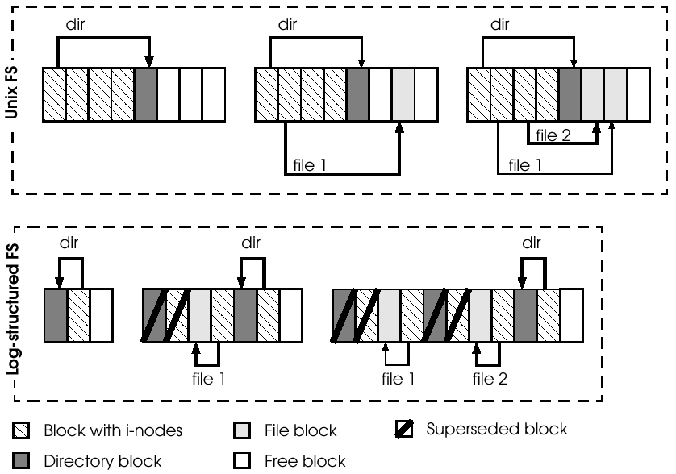
Differences Between Traditional Unix FS and Log-structured Ones

Slide 46
Physical Placement of Data (X)
Solving the Small-Write Problem
  Basic Idea
    Mixing the log-structured filesystem and the logical RAID so that small-writes never occur
  Using the cache to avoid writing until a large block is available, logging the parity, or building a two level RAID

Slide 47
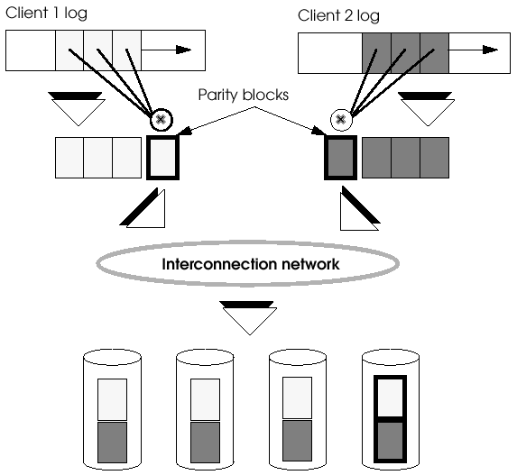
The Log-structured Filesystem as a Solution to the Small-write Problem in a Cluster of Workstations

Slide 48
Physical Placement of Data (XI)
Network-Attached Devices
  One of the problems in a file server
    The bandwidth of this disk is limited to the bandwidth of the memory in the server
    The operations in the server become I/O bottleneck
  To solve
    Network-attached devices
      I/O devices should be connected to a host & to a very high-bandwidth network
    Example
      RAID II system
      Global File System

Slide 49
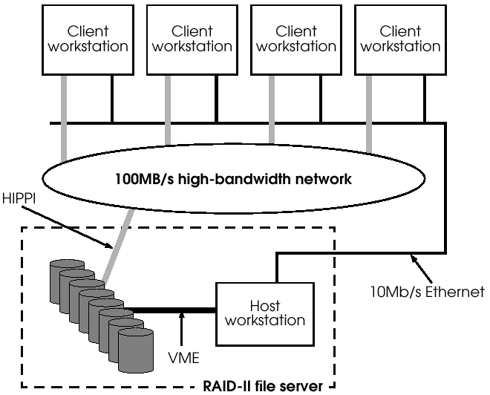
Example of a RAID-II File Server and Its Clients

Slide 50
Physical Placement of Data (XII)
Network-Attached Devices
  RAID-II system
    Three components
      A high bandwidth RAID
      The high bandwidth network
      A host node
  Global File System
    A prototype design for a distributed filesystem
    Contribution
      The locking mechanism

Slide 51
Caching (I)
Most important performance limitation
  Slow mechanical components
    Solutions, such as RAIDs, are not sufficient
  Caching mechanism was proposed
Caching mechanism
  Basic idea
    Keeping the file blocks used by the applications in memory buffers
  A filesystem cache or buffer cache
    To minimize the number of times the filesystem has to access the disks
    Increases the performance of read operations
    Increases the write performance

Slide 52
Caching (II)
Multilevel Caching
  Increases the effectiveness of the caching system
  The closer to the hardware the cache is, the less effective this cache is
    Most of locality has already been profited by the higher-level caches
  Possible locations of a disk cache in a cluster of workstation
    Cache at server side, client side, or even in both
      Use disks for storing remote information
    Cache-coherence problem

Slide 53
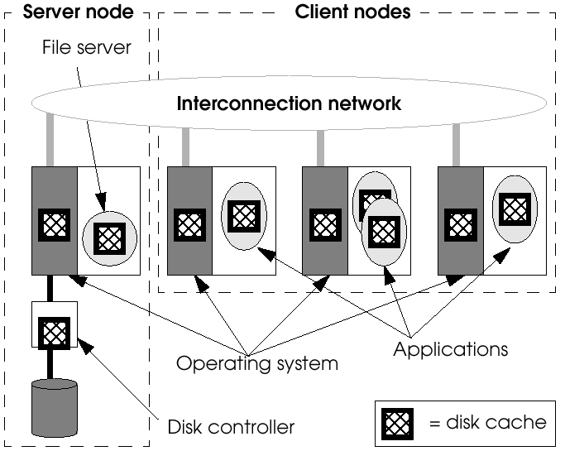
Possible Locations of a Disk Cache in a Cluster of Workstations

Slide 54
Caching (III)
Cache-Coherence Problems
  Approaches to solve
    Relaxing the sharing semantics
      session semantic
      transaction semantic
      semantic where files never change
    Find efficient algorithms that can fulfill the Unix semantic
      modified block is immediately seen by all applications in the system
      coherence algorithms

Slide 55
Caching (IV)
Cache-Coherence Problems
  File-sharing semantics
    Session semantic
      All modifications done on a file are visible only, at the same time, to the processes running on that node
      Once file is closed, all the modifications become visible to all the applications that open the modified file
      Example – AFS (Andrew File System)
    Transaction semantic
      All I/O operations are done between two control instructions
        Begin transaction & end transaction
      All modifications done between these two instructions will be invisible to the rest of the nodes until the transaction over
      Once the transaction is finished, all the modifications are propagated to the rest of the nodes
      DB-oriented filesystem
      Has been used in parallel/distributed systems
    Semantic where files never change
      Once a file is created it can never be modified

Slide 56
Caching (V)
Cache-Coherence Problems
  Coherence Algorithms
    Not allowing the caching of write operations when a file is shared
    Token
      Only node that has a token can modify the file
        On writing, invalidate copies
      Dead of node that has a token prevent other node from accessing file
      Token passing problem: failure and disconnect - expiration time
        Lease is needed
    Sharing unit (token & lease)
      Per file
      Per block
      User defined (area)
    ENWRICH scheme (intelligent) - mix with others: flush copy
      At file server, last version of copy is accepted

Slide 57
Caching (VI)
Cooperative Caching
  Assumption
    Each client node keeps in its cache the most important blocks for their applications
      I don’t need cache
      I need many cache
      Wanted block is already cached in other node
  Problem
    Application based cache management (greedy)
      The cache space is not well managed
    The file block needed by a node may already be cached in a different node

Slide 58
Caching (VII)
Traditional Cooperative Caches (xFS)
  The design issues of the cooperation cache
    Contents of all the client caches had to be accessible from any node in the network
    Singlets (the last remaining copy of block) kept in the cache as long as possible
    Physical locality was to be encouraged
      Blocks should be cached in the node that will most probably need them
  Cache is divided
    Local part
      Keep the blocks needed by this node
    Global part
      Keep the blocks needed by other nodes but cannot be kept in their caches

Slide 59
Caching (VIII)
Traditional Cooperative Caches
  Algorithm
    Replace block which is not singlet (LRU)
    If all is singlet, random forward
    Receiver node’s replacement policy is the same
    If any block is forwarded twice without being accessed by any application, discarded
    When remote hit occur, block is copied to local cache
  Drawbacks
    Cache coherency (local copy of a block)
      Complexity of system increases
    Cause of replication, cache is under utilized
    Overhead for locality is greater than benefits obtained by encouraging physical locality

Slide 60
Caching (IX)
New Generation in Cooperative Caching
  PAFS
    Main idea
      Build a big global cache!
      Ignore physical locality
    Advantages
      No replica, only one copy of a block exists
        No cache coherency problem
      More blocks can be cached, more effective
  PG-LRU
    Search for a block that is in the same node
    If this block is among the 5% of LRU blocks, this block is replaced ( 5% determination )
    Otherwise LRU is applied (regardless of node)

Slide 61
Prefetching (I)
Caching
  If blocks are used more than once
    increase system performance
  If blocks are used first time
    no increase system performance
Solution
  Prefetch theses blocks before they are requested by the user
Prefetching
  Which blocks are most likely to be accessed in the near future?
  Require sharing all the data structures and block predictor
  Devote to mono-processor systems
  How is previous prefetching technique applied in parallel/ distributed system?

Slide 62
Prefetching (II)
Parallel Prefetch
  The simplest idea
    Each node prefetches its data in an isolated way
  One-block-ahead prefetching
  Parallelism offered by the multiple disks
    Fulfill prefetching requests from each of the nodes
    Prefetch large blocks using a logical RAID
  Problem
    Lack of coordination in the prefetching
      not cooperative
      behave as the caches found in mono-processor system
    Can’t take advantage of the inherent parallelism of a cluster of workstations

Slide 63
Prefetching (III)
Transparent Informed Prefetching
  Many of application on a cluster of workstations is sequential
  Can not take advantage of the I/O parallelism
  A good idea if the system could prefetch large portions of the file in parallel
  User gives hint to the system (access pattern)
    Many blocks can be prefetched
    Can be performed in parallel
    Allows sequential application to take advantage of the parallelism
  Feature
    Allow to hint I/O system
    Better knowledge of the way files accessed
    Better prefetching
    Specifies the access pattern

Slide 64
Prefetching (IV)
Transparent Informed Prefetching
  A similar approach without the hints
    Require a predictor
      Decide predicted block
    If access patterns are specified, other node can prefetch all block expected => no cache miss
    Effect
      Perform very aggressive prefetching
      Prefetch all the blocks
      No miss predictions
    Problem
      Predictor decides which blocks have to be prefetched
        If many miss-predicted blocks occurs, system performance decreases

Slide 65
Prefetching (V)
Scheduling Parallel Prefetching and Caching
  Good prefetching and caching scheduling
    Achieve the best performance
  Non-best performance case
    If we prefetch blocks too early
      They may replace blocks that are still needed in the cache
    If we prefetch blocks too lately
      The applications will need to wait
  In a system with several disks
    This problem becomes even more complicated

Slide 66
Prefetching (VI)
Scheduling Parallel Prefetching and Caching
  Aggressive
    Initiate a prefetching whenever a disk is ready
    Replaces the block that will be referenced furthest in the future
    This should be started only if this new block does not replace another block that will be used sooner
    Bad for multiple disks when the load on the disks is unbalanced

Slide 67
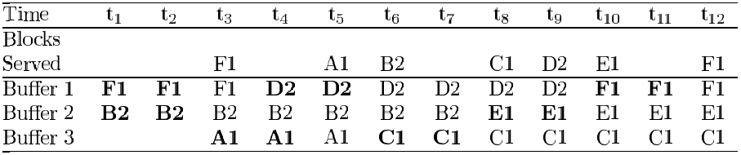
Prefetching Scheduling Made by Aggressive Algorithm
Example
  Suppose
    Two disks and a cache with three blocks
    Fetch a block for two units of time
    Fetch only one block per disk in parallel
  Stream of blocks : F1, A1, B2, C1, D2, E1, F1

Slide 68
Prefetching (VII)
Scheduling Parallel Prefetching and Caching
  Reverse Aggressive
    The problem with aggressive algorithm
      Achieve bad result when the load is unbalanced
    Select replacement decisions by balancing disk workload
      Build the reserved sequence of requests
      Build an aggressive scheduling
        avoid the replacement in parallel of blocks on the same disks
        fetch more than one blocks from the same disk
        stream of blocks are reserved sequence
      Transform this schedule back to a schedule for the original sequence
        from reserved sequence to forward sequence

Slide 69
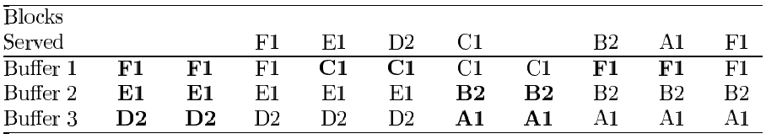
Scheduling of the Aggressive Algorithm on the Reversed Sequence
Stream of blocks : F1, A1, B2, C1, D2, E1, F1
Aggressive scheduling for the reverse sequence (F1, E1, D2, C1, B2, A1, and F1)

Slide 70
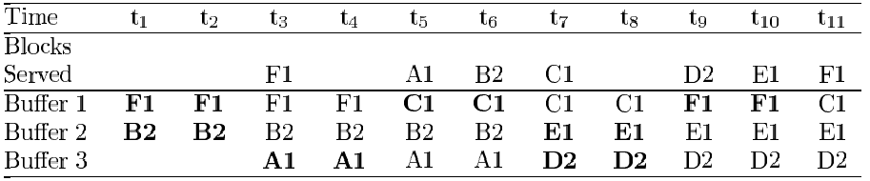
Prefetching Scheduling Obtained by the Reverse-Aggressive Algorithm
Stream of blocks : F1, A1, B2, C1, D2, E1, F1

Slide 71
Prefetching (VIII)
Scheduling Parallel Prefetching and Caching
  Difference
    Aggressive algorithm
      Choose evictions without considering the relative loads on the disks
      Can wastefully prefetch
    Reverse aggressive algorithm
      Greedily evicts as many disks as possible loads on the disks
      Can not wastefully than aggressive

Slide 72
Interface (I)
The higher layer in an I/O system is the interface with the user
  Allow the application to request the data from the I/O system
  Allow the user (or compiler) to inform system
There is a need to express the parallelism of the data kept in the filesystem
In parallel environments
  Traditional interfaces have become inadequate
  A good interface
    Share the data
    Cooperate when requesting the data
      express concepts of data parallelism and cooperative operations
No real standard parallel interface has been designed

Slide 73
Interface (II)
Traditional interface
  In mono-processor filesystems (specially Unix)
    File is a linear sequence of bytes - so need a pointer
      Mainly used operation
        open(), close(), read(), write(), seek()
    Can not have a shared pointer
      Each time open operation is performed, a new read/write pointer is created
      File pointer can be inherited to only child-process
    Can not read or write a set of non-contiguous regions
      Allow atomic read and write of sequential portions
  Inadequate to apply distributed/parallel system

Slide 74
Interface (III)
Shared File Pointer
  Allow several processes to work with the same file pointer
  The possibility to coordinate processes to access a share file in a cooperative way
  Kinds of share file pointers
    Global shared pointer
    Two special share pointer
    Distributed shared pointer
  Global shared pointer
    Allow all the applications
      share pointer with no limitation
      can be operations of any size and any order
    Difficult to implement efficiently in a distributed system

Slide 75
Interface (IV)
Shared File Pointer
  Two special shared pointers
    Allow all applications share pointer to access the file in round-robin order
    One allow each process to request any number of byte in each request, the second one all requests must be the same size
    Quite easy to implement
  Distributed shared pointer
    Avoid overlap files between data accessed by any two processes
    Allow each process
      access different (not overlapped) portion of file
      add as little overhead
    Based on round-robin scheduling

Slide 76
Interface (V)
Access Methods
  Strides
    Great number of the I/O operations done in a parallel environment use strided patterns
    Strided operation
      Accesses several pieces of data that are not contiguous but separated by a certain number of bytes
      Can not be handled easily nor efficiently using the traditional interface

Slide 77
Interface (VI)
Access Methods
  Three new interfaces by the Galley filesystem
    Simple-strided
      Allow the user to access to N blocks of M bytes placed P bytes apart from each other

Slide 78
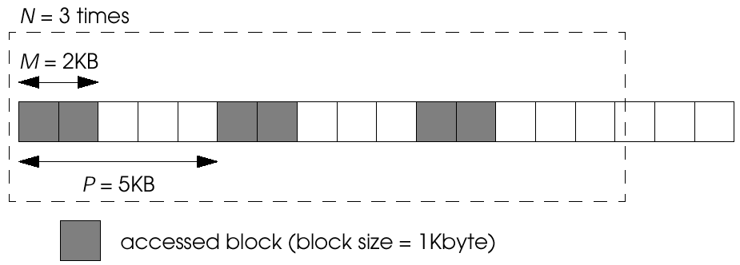
Example of a Simple-Strided Operation

Slide 79
Interface (VII)
Three new interfaces by the Galley filesystem
  Nested strided operation
    Build a vector of strides
      different levels of stride
    Last one stride level
      represents the placement of data blocks
    All other stride level
      indicate in which positions does the next level strides start
    Two-level strides
      First level: indicate next level
      second level: user wanted block

Slide 80
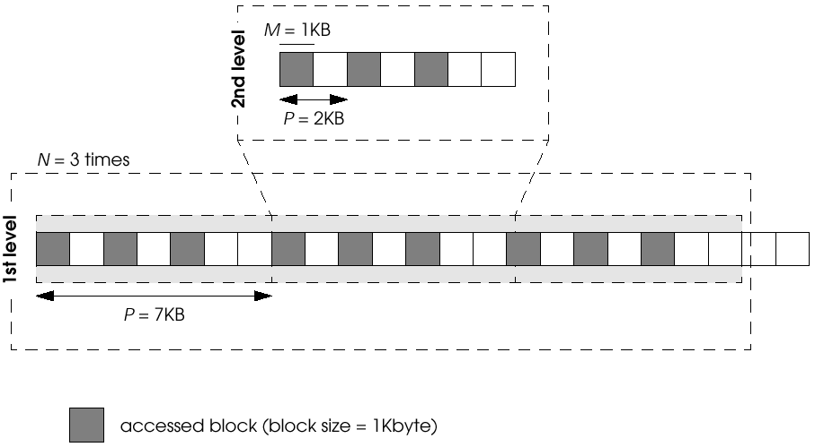
Example of a Nested-Strided Operation with Two Levels of Strides

Slide 81
Interface (VIII)
Three new interfaces by the Galley filesystem
  Nested-batched operation
    Make several simple and nested strided operations as a single operation
    Used as one of the parameters in the read or write operation

Slide 82
Interface (IX)
Access Methods
  MPI-IO
    I/O interface for MPI message-passing library
    Allow the user to specify the distribution of the file among the user space
    Designed with a very clear set of goal
    Targeted primarily for scientific applications

Slide 83
Interface (X)
MPI-IO
  Three steps in data partitioning
    First step
      Defines the size of the basic element or etype
      Element is used to construct the patterns needed in the next two steps
    Second step
      Done in the open operation
      Specify which parts of the complete file will be used to construct the opened subfile
      Specifies the filetype to describe a pattern of etypes
      Filetype defines the subfile to access
    Third step
      Can be done in each read/write operation
      User defines how the accessed elements should be placed in the buffer
      Built buftype from etypes
      Buftype
        a pattern telling the system where to place the elements

Slide 84
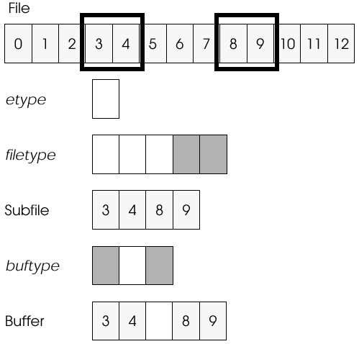
An Example of Data Partitioning in MPI-IO

Slide 85
Interface (XI)
Data Distribution
  Allow the user to decide
    How data was distributed among the disks
    How this data is to be accessed by the application
  Two-dimensional files (Vesta filesystem)
    Division of a file into cells and Basic Striping Units (BSUs)
      allow us to see the file as a two-dimensional array
    Cell
      contiguous portion of a file
      define at creation time
      remains constant during the whole life of the file
      each of the cell is placed in a different I/O node (disk)
      the number of cell equal the maximum parallelism
      placement is made by system with no interaction from the user
    BSU
      sets of bytes and behave as the basic data units
      used by repartition mechanism
      set at creation time
      remains unmodified during the whole life of the file

Slide 86
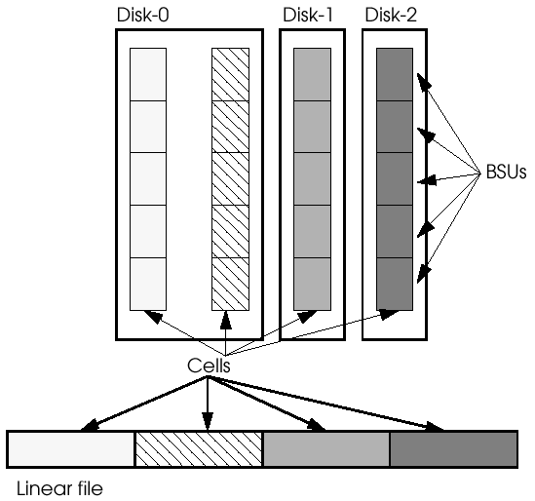
Schematic Representation of a Two-Dimensional File in Vesta

Slide 87
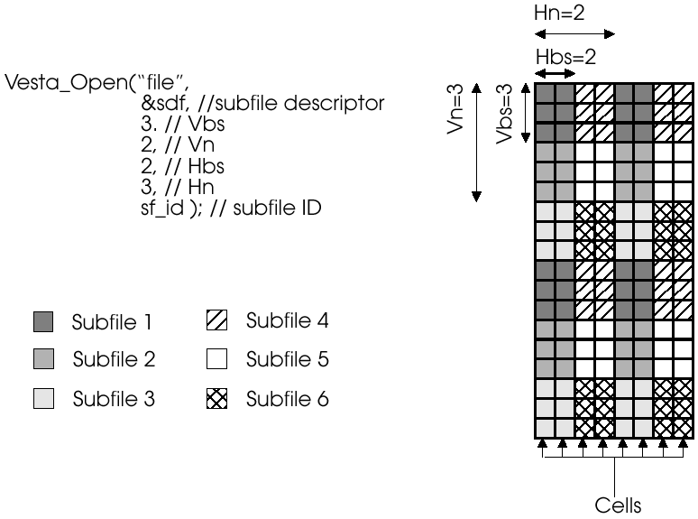
Example of an Open Operation in Vesta

Slide 88
Interface (XII)
Collective I/O
  As the degree of parallelism increases
    Many small I/O request occur (many seek operations occurs)
    If each process requests very few bytes in each operation
      not achieve high performance
  All computing nodes cooperate to perform I/O operations from the disk in order to improve efficiency
  Build a single big operation from all the small ones requested by each client

Slide 89
Interface (XIII)
Extensible Systems
  Users decide which algorithms are best suited for their application
  Caching and prefetching strategies
    Asynchronous operations (Paragon)
      Applications can decide what has to be prefetched and when it has to be done
    Choosing one of the predefined policies in kernel
    User-implemented policy

Slide 90

Reference Book

